Slide 1
Chapter 5: Network Layer
Chapter goals:
understand principles behind network layer services:
Network layer service models
Forwarding versus routing
how a router works
routing (path selection)
dealing with scale
instantiation and implementation in the Internet

Slide 2
Chapter 5: Network Layer
5.1 Introduction
5.2 Virtual circuit and datagram networks
5.3 What’s inside a router?
5.4 Routing algorithms:
Dijkstra’s algorithm
Broadcast routing
Link state
Distance vector
Hierarchical routing
5.5 Routing in the Internet
5.6 IP: Internet protocol
IPv4 Datagram format
IPv4 addressing
IP fragment
NAT
ARP
ICMP
IPv6

Slide 3
Keypoints and Difficulties
Keypoints:
Link state routing algorithm
Distance vector routing algorithm
IPv4
IPv6
Difficulties:
Virtual circuit and datagram networks
Subnet and Subnet Division
IP fragment

Slide 4
Network layer
application
transport
network
data link
physical
Transport packet from sending to receiving hosts
Network layer protocols in every host, router
Router examines header fields in all IP datagram passing through it
network
data link
physical
network
data link
physical
network
data link
physical
network
data link
physical
network
data link
physical
network
data link
physical
network
data link
physical
network
data link
physical
application
transport
network
data link
physical

Slide 5


Two key Network-layer functions
Routing: determine route taken by packets from source to dest.
Routing algorithms
Forwarding: move packets from router’s input to appropriate router output
Analogy:
Routing: process of planning trip from source to dest.
Forwarding: process of getting through single interchange
Connection setup: some network architectures require router connection setup along path before data flows.

Slide 6
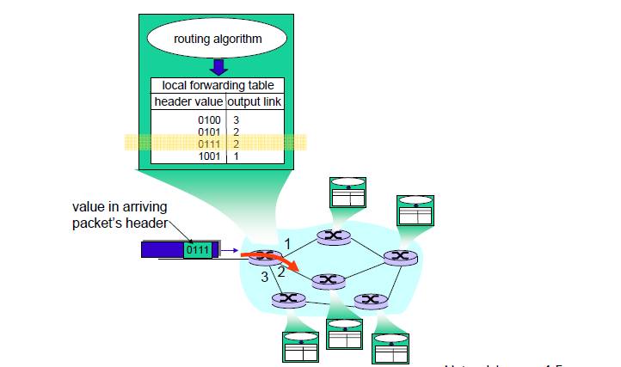
Interplay between routing and forwarding

Slide 7
Network service model
Q: What service model for “channel” transporting packets from sender to receiver?
guaranteed bandwidth?
preservation of inter-packet timing (no jitter)?
loss-free delivery?
in-order delivery?
congestion feedback to sender?
The most important
abstraction provided
by network layer:
?
?
virtual circuit
or
datagram?
?
service abstraction

Slide 8
Network layer connection and connection-less service
Datagram network provides network-layer connectionless service
VC network provides network-layer connection service
Analogous to the transport-layer services,but:
Service: host-to-host
No choice: network provides one to the other
Implementation: in network core

Slide 9
Network layer service models:
Network
Architecture
Internet
ATM
ATM
ATM
ATM
Service
Model
best effort
CBR
VBR
ABR
UBR
Guarantees ?
Congestion
feedback
no (inferred
via loss)
no
congestion
no
congestion
yes
no
Bandwidth
none
constant
rate
guaranteed
rate
guaranteed
minimum
none
Loss
no
yes
yes
no
no
Order
no
yes
yes
yes
yes
Timing
no
yes
yes
no
no

Slide 10
Chapter 5: Network Layer
5.1 Introduction
5.2 Virtual circuit and datagram networks
5.3 What’s inside a router?
5.4 Routing algorithms:
Dijkstra’s algorithm
Broadcast routing
Link state
Distance vector
Hierarchical routing
5.5 Routing in the Internet
5.6 IP: Internet protocol
IPv4 Datagram format
IPv4 addressing
IP fragment
NAT
ARP
ICMP
IPv6

Slide 11
Virtual circuits: signaling protocols
used to setup, maintain teardown VC
used in ATM, frame-relay, X.25
not used in today’s Internet
application
transport
network
data link
physical
5. Data flow begins
6. Receive data
application
transport
network
data link
physical
4. Call connected
3. Accept call
1. Initiate call
2. incoming call

Slide 12
Virtual circuits
“source-to-dest path behaves much like telephone circuit”
performance-wise
network actions along source-to-dest path
call setup, teardown for each call before data can flow
each packet carries VC identifier (not destination host OD)
every router on source-dest path s maintain “state” for each passing connection
transport-layer connection only involved two end systems
link, router resources (bandwidth, buffers) may be allocated to VC
to get circuit-like perf.

Slide 13

VC Implementation
A VC consists of:
1. Path from source to destination
2. VC numbers, one number for each link along path
3. Entries in forwarding tables in routers along path
Packet belonging to VC carries VC number(rather than dest. address)
VC number can be changed on each link
New VC number comes from forwarding table

Slide 14
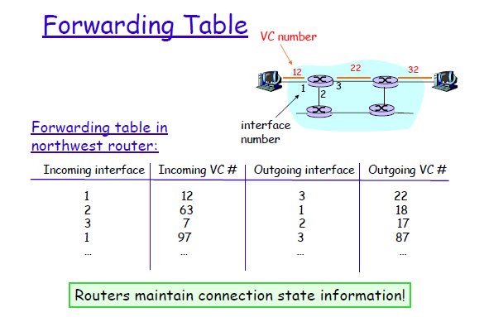

Slide 15
Datagram networks: the Internet model
no call setup at network layer
routers: no state about end-to-end connections
no network-level concept of “connection”
packets typically routed using destination host ID
packets between same source-dest pair may take different paths
application
transport
network
data link
physical
application
transport
network
data link
physical
1. Send data
2. Receive data

Slide 16
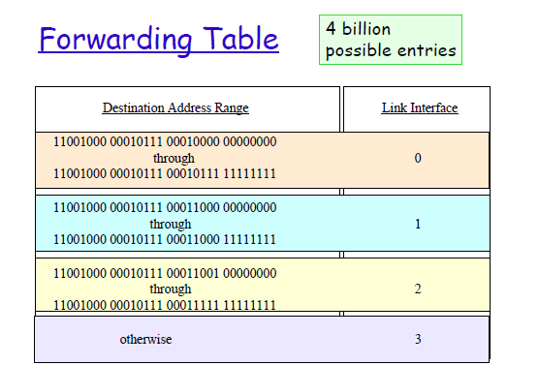

Slide 17
Longest prefix matching
when looking for forwarding table entry for given destination address, use longest address prefix that matches destination address
Destination Address Range
11001000 00010111 00010*** *********
11001000 00010111 00011000 *********
11001000 00010111 00011*** *********
otherwise
Link interface
0
1
2
3
examples:
DA: 11001000 00010111 00010110 10100001
which interface?
DA: 11001000 00010111 00011000 10101010
which interface?
Notes:
华科 vs 华科AIA

Slide 18
Datagram or VC network: why?
Internet
data exchange among computers
“elastic” service, no strict timing req.
“smart” end systems (computers)
can adapt, perform control, error recovery
simple inside network, complexity at “edge”
many link types
different characteristics
uniform service difficult
ATM
evolved from telephony
human conversation:
strict timing, reliability requirements
need for guaranteed service
“dumb” end systems
telephones
complexity inside network

Slide 19
Chapter 5: Network Layer
5.1 Introduction
5.2 Virtual circuit and datagram networks
5.3 What’s inside a router?
5.4 Routing algorithms:
Dijkstra’s algorithm
Broadcast routing
Link state
Distance vector
Hierarchical routing
5.5 Routing in the Internet
5.6 IP: Internet protocol
IPv4 Datagram format
IPv4 addressing
IP fragment
NAT
ARP
ICMP
IPv6

Slide 20
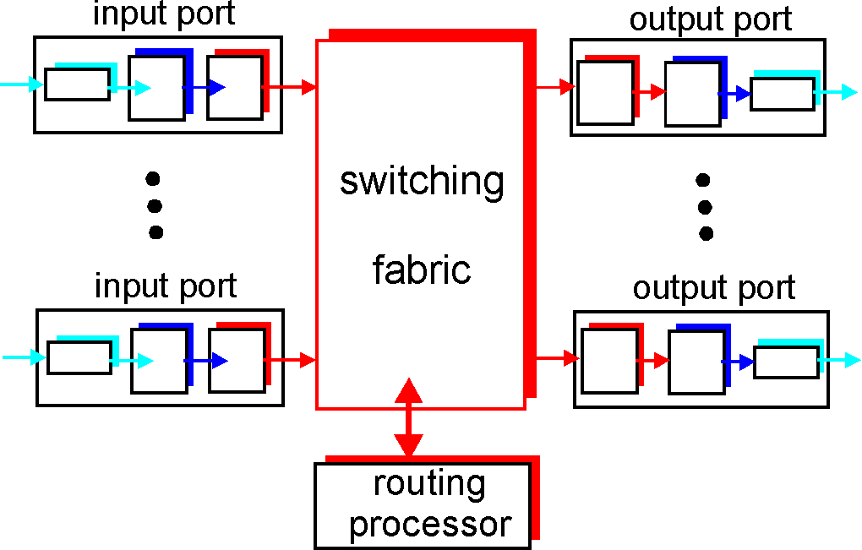
Router Architecture Overview
Two key router functions:
run routing algorithms/protocol (RIP, OSPF, BGP)
switching datagrams from incoming to outgoing link

Slide 21
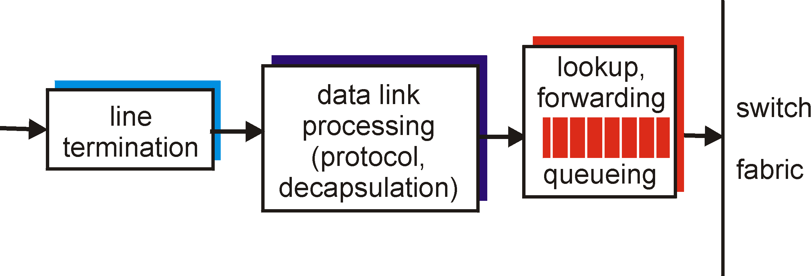
Input Port Functions
Physical layer:
bit-level reception
Data link layer:
e.g., Ethernet
Decentralized switching:
given datagram dest., lookup output port using routing table in input port memory
goal: complete input port processing at ‘line speed’
queuing: if datagrams arrive faster than forwarding rate into switch fabric

Slide 22
Input Port Queuing
Fabric slower that input ports combined -> queueing may occur at input queues
queueing delay and loss due to input buffer overflow!
Head-of-the-Line (HOL) blocking: queued datagram at front of queue prevents others in queue from moving forward
switch
fabric
switch
fabric
output port contention:
only one red datagram can be transferred. lower red packet is blocked
one packet time later: green packet experiences HOL blocking

Slide 23
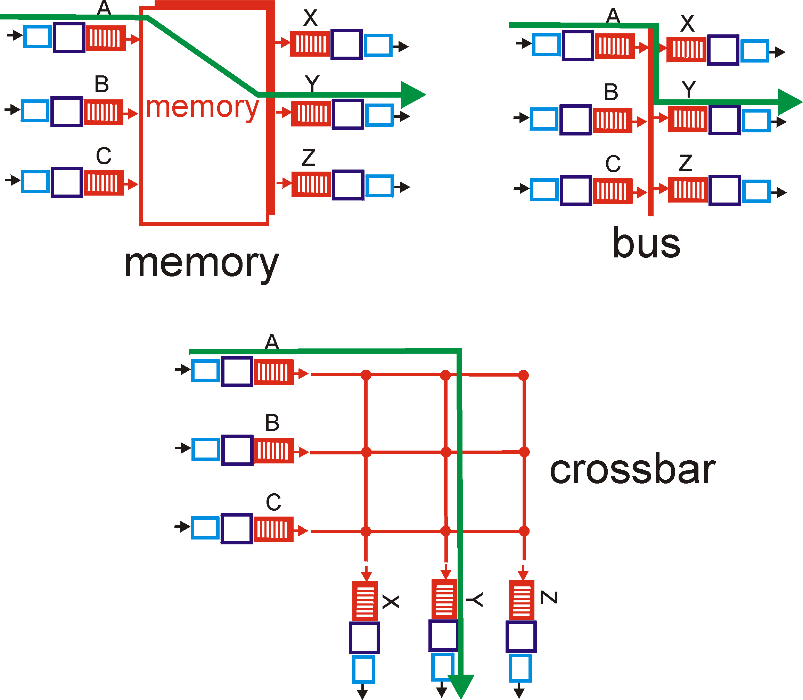
Three types of switching fabrics

Slide 24
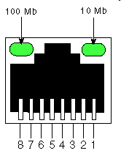
Switching Via Memory
First generation routers:
packet copied by system’s (single) CPU
speed limited by memory bandwidth (2 bus crossings per datagram)
input
port
(e.g.,
Ethernet)
output
port
(e.g.,
Ethernet)
memory
system bus
Modern routers:
input port processor performs lookup, copy into memory
Cisco Catalyst 8500

Slide 25
Switching Via Bus
datagram from input port memory
to output port memory via a shared bus
bus contention: switching speed limited by bus bandwidth
32 Gbps bus, Cisco 5600: sufficient speed for access and enterprise routers

Slide 26
Switching Via An Interconnection Network
overcome bus bandwidth limitations
Banyan networks, crossbar, other interconnection nets initially developed to connect processors in multiprocessor
Advanced design: fragmenting datagram into fixed length cells, switch cells through the fabric.
Cisco 12000: switches 60 Gbps through the interconnection network
crossbar

Slide 27
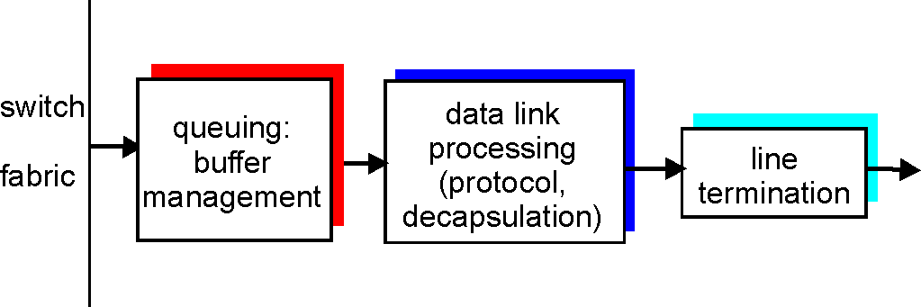
Output Ports
Datagram (packets) can be lost due to congestion, lack of buffers
Buffering required when datagrams arrive from fabric faster than the transmission rate
Scheduling discipline chooses among queued datagrams for transmission
Priority scheduling – who gets best performance, network neutrality

Slide 28
Output port queueing
switch
fabric
switch
fabric
at t, packets more
from input to output
one packet time later
buffering when arrival rate via switch exceeeds ouput line speed
queueing (delay) and loss due to output port buffer overflow!

Slide 29
Chapter 5: Network Layer
5.1 Introduction
5.2 Virtual circuit and datagram networks
5.3 What’s inside a router?
5.4 Routing algorithms:
Dijkstra’s algorithm
Broadcast routing
Link state
Distance vector
Hierarchical routing
5.5 Routing in the Internet
5.6 IP: Internet protocol
IPv4 Datagram format
IPv4 addressing
IP fragment
NAT
ARP
ICMP
IPv6

Slide 30
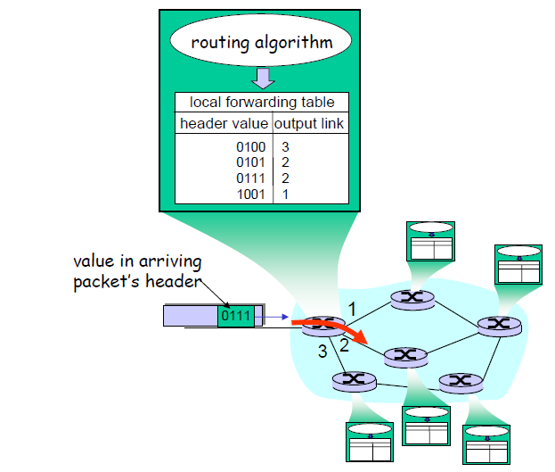
Interplay between routing and forwarding

Slide 31
Routing
Routing protocol
Goal: determine “good” path
(sequence of routers) thru
network from source to dest.
5
B
3
C
2
5
A
2
1
F
Graph abstraction for routing algorithms:
graph nodes are routers
graph edges are physical links
link cost: delay, $ cost, or congestion level
3
1
2
D
E
1
“good” path:
typically means minimum cost path
other def’s possible

Slide 32
Graph abstraction of the network
5
v
3
w
2
5
u
2
1
z
3
1
2
x
y
1
graph: G = (N,E)
N = set of routers = { u, v, w, x, y, z }
E = set of links ={ (u,v), (u,x), (v,x), (v,w), (x,w), (x,y), (w,y), (w,z), (y,z) }
aside: graph abstraction is useful in other network contexts, e.g.,
P2P, where N is set of peers and E is set of TCP connections

Slide 33
Graph abstraction: costs
5
c(x,x’) = cost of link (x,x’)
e.g., c(w,z) = 5
cost could always be 1, or
inversely related to bandwidth,
or inversely related to
congestion
v
3
w
2
5
u
2
1
z
3
1
2
x
y
1
cost of path (x₁, x₂, x₃,…, x_{p}) = c(x₁,x₂) + c(x₂,x₃) + … + c(x_{p-1},x_{p})
key question: what is the least-cost path between u and z ?
routing algorithm: algorithm that finds that least cost path

Slide 34
Routing Algorithm classification
Global or decentralized information?
Global:
all routers have complete topology, link cost info
“link state” algorithms
Decentralized:
router knows physically-connected neighbors, link costs to neighbors
iterative process of computation, exchange of info with neighbors
“distance vector” algorithms
Static or dynamic?
Static:
routes change slowly over time
Dynamic:
routes change more quickly
periodic update
in response to link cost changes

Slide 35
Dijkstra’s algorithm
Net topology,link costs known to all nodes
Computes least cost paths from one node(source) to all other nodes
Iterative: after k iterations, know least cost path to k dest.’s
Notation:
c(x,y): link cost from node x to y; = ∞ if not direct neighbors
D(v): current value of cost of path from source to dest. V
p(v): predecessor node along path from source to v
N’: set of nodes whose least cost path definitively known

Slide 36
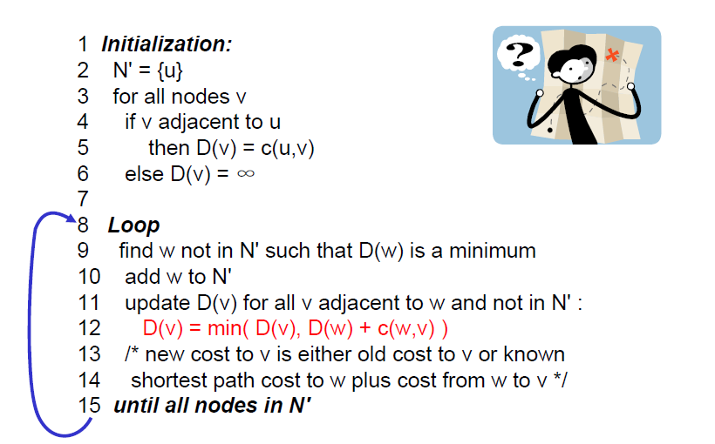
Dijkstra’s algorithm

Slide 37
Dijkstra’s algorithm: example
D(v)
p(v)
D(w)
p(w)
D(x)
p(x)
D(y)
p(y)
D(z)
p(z)
Step
N'
0
u
7,u
3,u
5,u
∞
∞
1
uw
6,w
5,u
11,w
∞
2
uwx
6,w
11,w
14,x
3
uwxv
10,v
14,x
4
uwxvy
12,y
5
uwxvyz
x
9
notes:
construct shortest path tree by tracing predecessor nodes
ties can exist (can be broken arbitrarily)
5
7
4
8
u
3
w
y
z
2
3
7
4
v

Slide 38
Dijkstra’s algorithm: another example
Step
0
1
2
3
4
5
N'
u
ux
uxy
uxyv
uxyvw
uxyvwz
D(v),p(v)
2,u
2,u
2,u
D(w),p(w)
5,u
4,x
3,y
3,y
D(x),p(x)
1,u
D(y),p(y)
∞
2,x
D(z),p(z)
∞
∞
4,y
4,y
4,y
5
v
3
w
2
5
u
2
1
z
3
1
2
x
y
1
* Check out the online interactive exercises for more examples: http://gaia.cs.umass.edu/kurose_ross/interactive/

Slide 39
Dijkstra’s algorithm: example (2)
resulting shortest-path tree from u:
v
w
u
z
x
y
resulting forwarding table in u:
destination
link
v
(u,v)
x
(u,x)
y
(u,x)
w
(u,x)
z
(u,x)

Slide 40
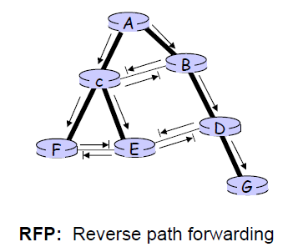
Broadcast routing
Flooding: Deliver packets from source to all other nodes
Broadcast storm
Controlled flooding:
Sequence-number-controlled flooding: add ID + broadcast sequence number into the broadcast packets
reverse path forwarding, RPF
Be able to avoid the broadcast storm

Slide 41
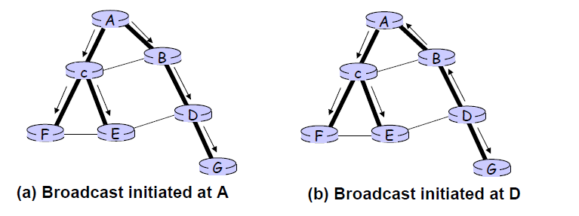
Broadcast routing
Spanning-tree broadcast
Suppose you have a connected undirected graph
…then a spanning tree of the graph is a connected subgraph in which there are no cycles
Be able to avoid the transmission of redundancy broadcast packets

Slide 42
Link state algorithm
Broadcast routing + Dijkstra’s algorithm
Having each node broadcast link-state packets to all other nodes → all nodes have an identical and complete view of the network.
Using Dijkstra’s algorithm compute the least-cost path from one node to all other nodes in the network
If a link cost changes, re-broadcast and re-compute

Slide 43
Link state algorithm,discussion
Algorithm complexity: n nodes
Each iteration: need to check all nodes, w, not in N
N(n+1)/2 comparisons:O(n²)
More efficient implementations possible: O(nlogn)
Oscillations possible:
E.g., link cost = amount of carried traffic
A
A
A
A
1
1+e
2+e
0
0
2+e
2+e
0
D
B
D
B
D
B
D
B
0
0
1+e
1
0
0
1+e
1
0
C
e
0
0
1
0
0
1
C
C
1+e
C
1
e
initially
given these costs,
find new routing….
resulting in new costs
given these costs,
find new routing….
resulting in new costs
given these costs,
find new routing….
resulting in new costs

Slide 44
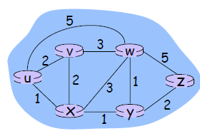
Distance vector algorithm
Bellman-Ford equation (dynamic programming)
Define
d_{x}(y) := cost of least-cost path from x to y
Then
d_{x}(y)=min_{v} ｛c(x,v)+d_{v}(y)｝
where min is taken over all neighbors v of x
For example:
Clearly, d_{v}(z)=5, d_{w}(z)=3, d_{x}(z)=3
B-F equation says:
d_{u}(z)=min｛c(u,v)+d_{v}(z), c(u,x)+d_{x}(z),
c(u,w)+d_{w}(z)｝
=min(2+5,1+3,5+3)=4

Slide 45
Distdance vector algorithm
D_{x}(y) = estimate of least cost from x to y
x maintains distance vector D_{x} = [D_{x}(y): y є N ]
node x:
knows cost to each neighbor v: c(x,v)
maintains its neighbors’ distance vectors. For each neighbor v, x maintains D_{v} = [D_{v}(y): y є N ]

Slide 46
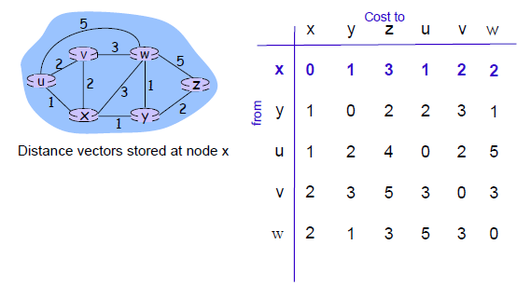
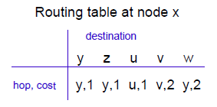
Bellman-Ford Example

Slide 47
Distdance vector algorithm
Basic idea:
Each node periodically sends its own distance vector estimate to neighbors
When a node x receives new DV estimate from neighbor, it updates its own DV using B-F equation
D_{x}(y) ← min_{v}{c(x,v)+D_{v}(y)} for each node yє N
Under minor, natural conditions, the estimate D_{x}(y) converge to the actual least cost d_{x}(y)

Slide 48
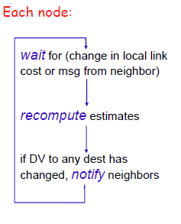
Distance vector algorithm
Iterative, asynchronous:
Each local iteration caused by:
Local link cost change
DV update message from neighbor
Distributed:
Each node notifies neighbors only when its DV change
Neighbors then notify their neighbors if necessary

Slide 49
D_{x}(z) = min{c(x,y) + D_{y}(z), c(x,z) + D_{z}(z)}
= min{2+1 , 7+0} = 3
D_{x}(y) = min{c(x,y) + D_{y}(y), c(x,z) + D_{z}(y)} = min{2+0 , 7+1} = 2
node x
table
cost to
cost to
x y z
x y z
x
0 2 7
x
0
2
3
y
y
2 0 1
from
∞
∞
∞
from
z
∞
∞
∞
z
7 1 0
node y
table
cost to
x y z
y
2
1
x
∞
∞
z
∞
2 0 1
x
from
y
7
z
∞
∞
∞
node z
table
cost to
x y z
x
∞ ∞ ∞
from
y
∞
∞
∞
z
7
1
0
time

Slide 50
D_{x}(z) = min{c(x,y) + D_{y}(z), c(x,z) + D_{z}(z)}
= min{2+1 , 7+0} = 3
D_{x}(y) = min{c(x,y) + D_{y}(y), c(x,z) + D_{z}(y)} = min{2+0 , 7+1} = 2
node x
table
cost to
cost to
cost to
x y z
x y z
x y z
x
0 2 7
x
0
2
3
x
0 2 3
y
y
2 0 1
from
∞
∞
∞
from
y
2 0 1
z
z
from
∞
∞
∞
7 1 0
z
3 1 0
node y
table
cost to
cost to
cost to
x y z
x y z
x y z
y
2
1
x
∞
∞
x
0 2 7
∞
2 0 1
x
0 2 3
x
z
from
y
y
2 0 1
y
7
from
from
2 0 1
z
∞
∞
∞
z
7 1 0
z
3 1 0
node z
table
cost to
cost to
cost to
x y z
x y z
x y z
x
∞ ∞ ∞
x
0 2 7
x
0 2 3
y
y
2 0 1
from
y
∞
∞
from
2 0 1
from
∞
z
z
3 1 0
z
3 1 0
7
1
0
time
time

Slide 51
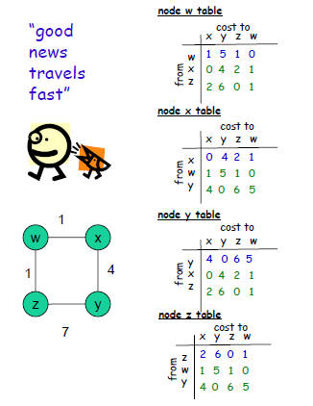
Distance vector: link cost changes
Link cost changes:
Node detects local link cost change
Updates routing info, recalculates distance vector
If DV changes, notigy neighbors
“good news travels fast, bad news travels slow”

Slide 52
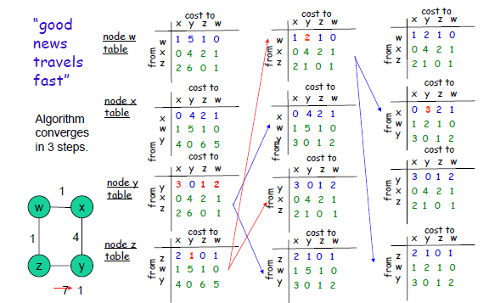

Slide 53
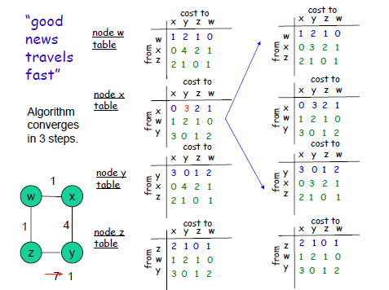

Slide 54
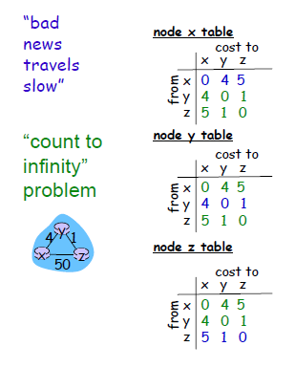
Count to infinity problem
Link cost changes:
good news travels fast
Bad news travels slow – “count to infinity” problem!
for example:
44 iterations before algorithm stabilizes

Slide 55
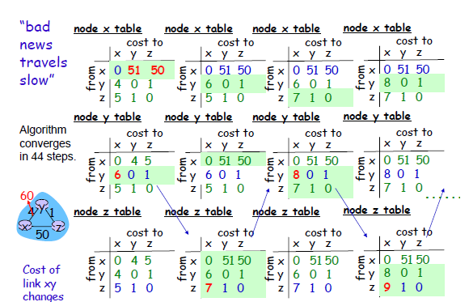

Slide 56
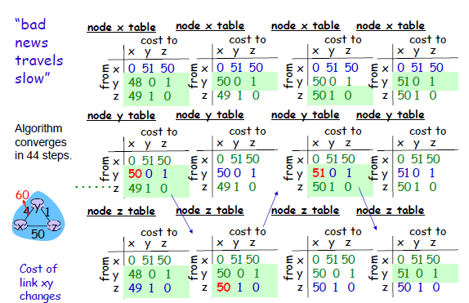

Slide 57
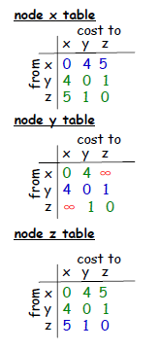
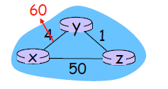
How to solve count to infinity problem?
Poisoned reverse:
If Z routes through Y to get to X:
Z tells Y its (Z’s) distance to X is infinite (so Y won’t route to X via Z)
Will this completely solve count to infinity problem?

Slide 58
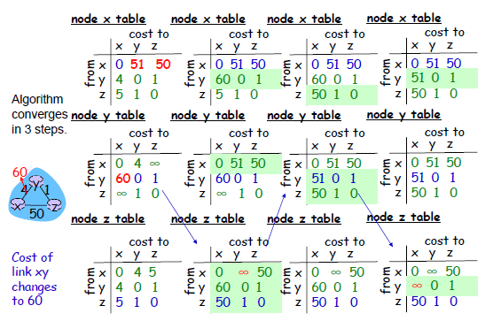

Slide 59
Comparison of LS and DV algorithms
Message complexity
LS: with n nodes, E links, O(nE) msgs sent
DV: exchange between neighbors only
Convergence time varies
Speed of convergence
LS: O(n²) algorithm requires O(nE) msgs
may have oscillations
DV:convergence time varies
may be routing loops
count-to-infinity problem
Robustness: what happens if router malfunctions?
LS:
Node can advertise incorrect link cost
Each node computes only its own table
DV:
DV node can advertise incorrect path cost
Each node’s table used by others
Error propagate thru network

Slide 60
Hierarchical Routing
Our routing study thus far - idealization
all routers identical
network “flat”
… not true in practice
scale: with billions of destinations:
can’t store all dest’s in routing tables!
routing table exchange would swamp links!
administrative autonomy
internet = network of networks
each network admin may want to control routing in its own network

Slide 61
Hierarchical Routing
aggregate routers into regions, “autonomous systems” (AS)
routers in same AS run same routing protocol
“intra-AS” routing protocol
routers in different AS can run different intra-AS routing protocol
gateway routers
special routers in AS
run intra-AS routing protocol with all other routers in AS
also responsible for routing to destinations outside AS
run inter-AS routing protocol with other gateway routers

Slide 62
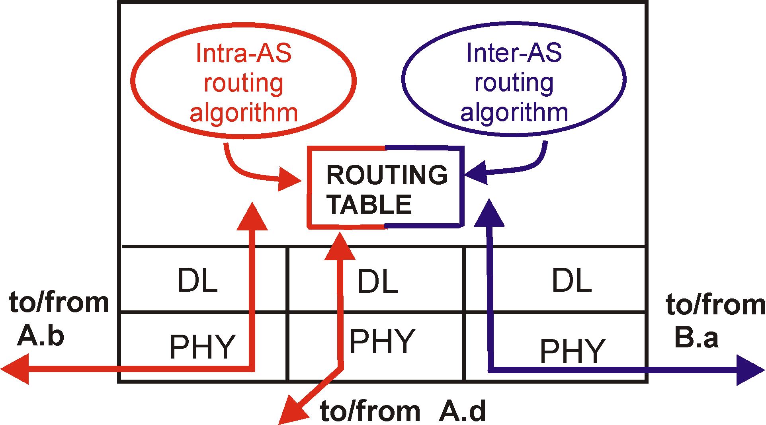
Intra-AS and Inter-AS routing
C.b
Gateways:
perform inter-AS routing amongst themselves
perform intra-AS routers with other routers in their AS
B.a
A.a
b
A.c
c
a
C
a
b
a
B
d
c
A
b
network layer
inter-AS, intra-AS routing in
gateway A.c
link layer
physical layer

Slide 63
Intra-AS and Inter-AS routing
Inter-AS
routing
between
A and B
C.b
B.a
A.a
Host
h2
b
A.c
c
a
C
a
b
a
B
Host
h1
d
c
Intra-AS routing
within AS B
A
b
Intra-AS routing
within AS A
We’ll examine specific inter-AS and intra-AS Internet routing protocols shortly

Slide 64
Routing in the Internet
The Global Internet consists of Autonomous Systems (AS) interconnected with each other:
Stub AS: small corporation
Multihomed AS: large corporation (no transit)
Transit AS: provider
Two-level routing:
Intra-AS: administrator is responsible for choice
Inter-AS: unique standard

Slide 65
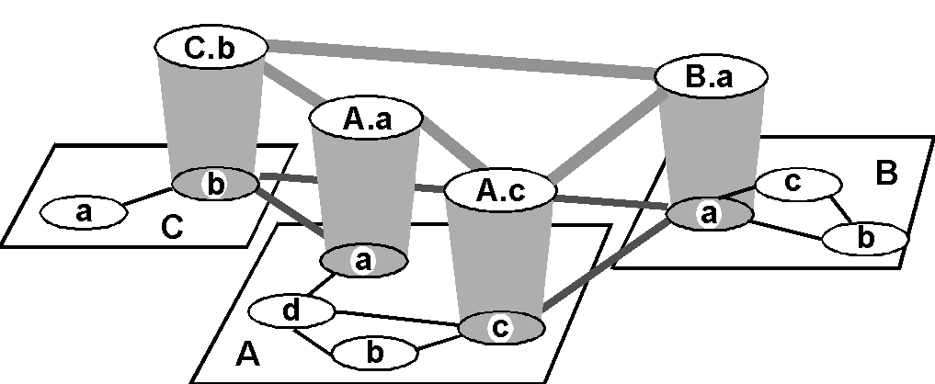
Internet AS Hierarchy
Inter-AS border (exterior gateway) routers
Intra-AS interior (gateway) routers

Slide 66
Chapter 5: Network Layer
5.1 Introduction
5.2 Virtual circuit and datagram networks
5.3 What’s inside a router?
5.4 Routing algorithms:
Dijkstra’s algorithm
Broadcast routing
Link state
Distance vector
Hierarchical routing
5.5 Routing in the Internet
5.6 IP: Internet protocol
IPv4 Datagram format
IPv4 addressing
IP fragment
NAT
ARP
ICMP
IPv6

Slide 67
Intra-AS Routing
Also known as Interior Gateway Protocols (IGP)
Most common intra-AS routing protocols:
RIP: Routing Information Protocol
OSPF: Open Shortest Path First
IGRP: Interior Gateway Routing Protocol
(Cisco proprietary for decades, until 2016)

Slide 68
RIP ( Routing Information Protocol)
Distance vector algorithm
Included in BSD-UNIX Distribution in 1982
Distance metric: # of hops (max = 15 hops)
Can you guess why?
Distance vectors: exchanged every 30 sec via Response Message (also called advertisement)
Each advertisement: route to up to 25 destination nets

Slide 69
RIP (Routing Information Protocol)
z
w
x
y
A
D
B
C
Destination Network Next Router Num. of hops to dest.
w A 2
y B 2
z B 7
x -- 1
…. …. ....
Routing table in D

Slide 70
RIP: Link Failure and Recovery
If no advertisement heard after 180 sec --> neighbor/link declared dead
routes via neighbor invalidated
new advertisements sent to neighbors
neighbors in turn send out new advertisements (if tables changed)
link failure info quickly propagates to entire net
poison reverse used to prevent ping-pong loops (infinite distance = 16 hops)

Slide 71
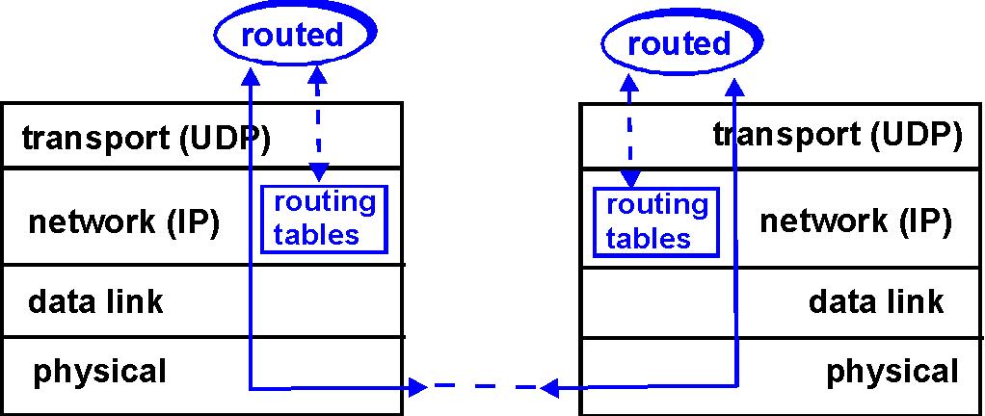
RIP Table processing
RIP routing tables managed by application-level process called route-d (daemon)
advertisements sent in UDP packets, periodically repeated

Slide 72
RIP Table example (continued)
Router: giroflee.eurocom.fr
Destination Gateway Flags Ref Use Interface
-------------------- -------------------- ----- ----- ------ ---------
127.0.0.1 127.0.0.1 UH 0 26492 lo0
192.168.2. 192.168.2.5 U 2 13 fa0
193.55.114. 193.55.114.6 U 3 58503 le0
192.168.3. 192.168.3.5 U 2 25 qaa0
224.0.0.0 193.55.114.6 U 3 0 le0
default 193.55.114.129 UG 0 143454
Three attached class C networks (LANs)
Router only knows routes to attached LANs
Default router used to “go up”
Route multicast address: 224.0.0.0
Loopback interface (for debugging)

Slide 73
OSPF (Open Shortest Path First)
“open”: publicly available
Uses Link -State algorithm
LS packet dissemination
Topology map at each node
Route computation using Dijkstra’s algorithm
OSPF advertisements are disseminated to entire AS (via flooding)
Link state advertisements are periodically updated
OSPF advertisements in OSPF messages are carried directly by IP

Slide 74
OSPF “advanced” features (not in RIP)
Security: all OSPF messages authenticated (to prevent malicious intrusion); TCP connections used
Multiple same-cost paths allowed (only one path in RIP)
For each link, multiple cost metrics for different TOS (eg, satellite link cost set “low” for best effort; high for real time)
Integrated uni- and multicast support:
Multicast OSPF (MOSPF) uses same topology data base as OSPF
Hierarchical OSPF in large domains.

Slide 75
Hierarchical OSPF
boundary router
backbone router
backbone
area
border
routers
area 3
internal
routers
area 1
area 2

Slide 76
Hierarchical OSPF
Two-level hierarchy: local area, backbone.
Link-state advertisements only in area
each nodes has detailed area topology; only know direction (shortest path) to nets in other areas.
Area border routers: “summarize” distances to nets in own area, advertise to other Area Border routers.
Backbone routers: run OSPF routing limited to backbone.
Boundary routers: connect to other ASs.

Slide 77
IGRP (Interior Gateway Routing Protocol)
CISCO proprietary; successor of RIP (mid 80s)
Distance Vector, like RIP
several cost metrics (delay, bandwidth, reliability, load etc)
uses TCP to exchange routing updates
Loop-free routing via Distributed Updating Alg. (DUAL) based on diffused computation

Slide 78
Inter-AS routing

Slide 79
Internet inter-AS routing: BGP
BGP (Border Gateway Protocol): the de facto inter-domain routing protocol
Path Vector protocol:
similar to Distance Vector protocol
each Border Gateway broadcast to neighbors (peers) entire path (I.e, sequence of ASs) to destination
E.g., Gateway X may send its path to dest. Z:
Path (X,Z) = X,Y1,Y2,Y3,…,Z

Slide 80
Internet inter-AS routing: BGP
BGP (Border Gateway Protocol): the de facto standard
BGP provides each AS a means to:
Obtain subnet reachability information from neighboring ASs.
Propagate reachability information to all AS-internal routers.
Determine good routes to subnets based on reachability information and policy.
Allows subnet to advertise its existence to the rest of Internet: “I am here”

Slide 81
BGP route selection
Router may learn about more than 1 route to some prefix. Router must select route
Elimination rules:
Local preference value attribute: policy decision
Shortest AS-PATH
Closest NEXT-HOP router: hot potato routing
Additional criteria

Slide 82
Internet inter-AS routing: BGP
Suppose: gateway X send its path to peer gateway W
W may or may not select path offered by X
cost, policy (don’t route via competitors AS), loop prevention reasons.
If W selects path advertised by X, then:
Path (W,Z) = w, Path (X,Z)
Note: X can control incoming traffic by controling it route advertisements to peers:
e.g., don’t want to route traffic to Z -> don’t advertise any routes to Z

Slide 83
Internet inter-AS routing: BGP
BGP messages exchanged using TCP.
BGP messages:
OPEN: opens TCP connection to peer and authenticates sender
UPDATE: advertises new path (or withdraws old)
KEEPALIVE keeps connection alive in absence of UPDATES; also ACKs OPEN request
NOTIFICATION: reports errors in previous msg; also used to close connection

Slide 84
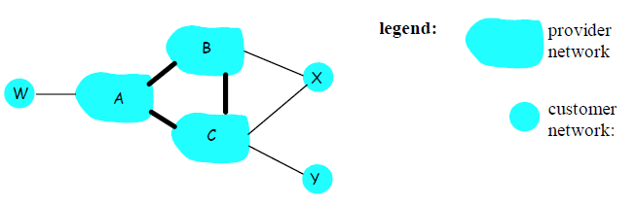
BGP Routing Policy
A,B,C are provider networks
X,W,Y are customer (of provider networks)
X is dual-homed: attached to two networks
X does not want to route from B via X to C
…so X will not advertise to B a route to C

Slide 85
BGP Routing Policy
A advertises to B the path AW
B advertises to X the path BAW
Should B advertise to C the path BAW?
No way! B gets no “revenue” for routing CBAW since neither W nor C are B’s customers
B wants to force C to route to W via A
B wants to route only to/from its customers!

Slide 86
Why different Intra- and Inter-AS routing ?
Policy:
Inter-AS: admin wants control over how its traffic routed, who routes through its net.
Intra-AS: single admin, so no policy decisions needed
Scale:
hierarchical routing saves table size, reduced update traffic
Performance:
Intra-AS: can focus on performance
Inter-AS: policy may dominate over performance

Slide 87
Exercises-1
The protocols for directly encapsulating RIP、 OSPF and BGP messages are
A. TCP、UDP、IP
B. TCP、IP、UDP
C. UDP、TCP、IP
D. UDP、IP、TCP
Notes:
D

Slide 88
*Network layer: data plane, control plane
Data plane
local, per-router function
determines how datagram arriving on router input port is forwarded to router output port
forwarding function
Control plane
network-wide logic
determines how datagram is routed among routers along end-end path from source host to destination host
two control-plane approaches:
traditional routing algorithms: implemented in routers
software-defined networking (SDN): implemented in (remote) servers
values in arriving
packet header
0111
1
3
2

Slide 89

*Per-router control plane
Individual routing algorithm components in each and every router interact in the control plane
Routing
Algorithm
control
plane
data
plane
values in arriving
packet header
0111
1
3
2

Slide 90
*Logically centralized control plane
A distinct (typically remote) controller interacts with local control agents (CAs)
Remote Controller
control
plane
data
plane
CA
CA
CA
CA
CA
values in arriving
packet header
0111
1
3
2

Slide 91
*Generalized Forwarding and SDN
Each router contains a flow table that is computed and distributed by a logically centralized routing controller
logically-centralized routing controller
control plane
data plane
local flow table
headers counters actions
1
0100 1101
3
2
values in arriving
packet’s header

Slide 92
*OpenFlow: Flow Table Entries
Rule
Action
Stats
Packet + byte counters
Forward packet to port(s)
Encapsulate and forward to controller
Drop packet
Send to normal processing pipeline
Modify Fields
Switch
Port
VLAN
ID
MAC
src
MAC
dst
Eth
type
IP
Src
IP
Dst
IP
Prot
TCP
sport
TCP
dport
Link layer
Network layer
Transport layer
Notes:
Now I’ll describe the API that tries to meet these goals.
92

Slide 93
*OpenFlow abstraction
match+action: unifies different kinds of devices
Router
match: longest destination IP prefix
action: forward out a link
Switch
match: destination MAC address
action: forward or flood
Firewall
match: IP addresses and TCP/UDP port numbers
action: permit or deny
NAT
match: IP address and port
action: rewrite address and port

Slide 94


*OpenFlow example
Example: datagrams from hosts h5 and h6 should be sent to h3 or h4, via s1 and from there to s2
match
action
IP Src = 10.3.*.*
IP Dst = 10.2.*.*
forward(3)
Host h6
10.3.0.6
1
s3
controller
2
3
4
Host h5
10.3.0.5
1
s1
s2
1
2
Host h4
10.2.0.4
4
2
4
Host h1
10.1.0.1
3
3
Host h2
10.1.0.2
match
action
match
action
Host h3
10.2.0.3
ingress port = 2
IP Dst = 10.2.0.3
ingress port = 2
IP Dst = 10.2.0.4
forward(3)
ingress port = 1
IP Src = 10.3.*.*
IP Dst = 10.2.*.*
forward(4)
forward(4)

Slide 95
Homework
P455:R4,R5
P457:P3,P5
P458:P11
P396:P14

Slide 96
Chapter 5: Network Layer
5.1 Introduction
5.2 Virtual circuit and datagram networks
5.3 What’s inside a router?
5.4 Routing algorithms:
Dijkstra’s algorithm
Broadcast routing
Link state
Distance vector
Hierarchical routing
5.5 Routing in the Internet
5.6 IP: Internet protocol
IPv4 Datagram format
IPv4 addressing
IP fragment
NAT
ARP
ICMP
IPv6

Slide 97
The Internet Network layer
Host, router network layer functions:
Transport layer: TCP, UDP
Routing protocols
path selection
RIP, OSPF, BGP
IP protocol
addressing conventions
datagram format
packet handling conventions
Network
layer
routing
table
ICMP protocol
error reporting
router “signaling”
Link layer
physical layer

Slide 98
IP datagram format
IP protocol version
number
32 bits
total datagram
length (bytes)
header length
(bytes)
head.
len
type of
service
ver
length
for
fragmentation/
reassembly
“type” of data
flgs
fragment
offset
16-bit identifier
max number
remaining hops
(decremented at
each router)
time to
live
upper
layer
header
checksum
32 bit source IP address
upper layer protocol
to deliver payload to
32 bit destination IP address
options (if any)
e.g. timestamp,
record route
taken, specify
list of routers
to visit.
data
(variable length,
typically a TCP
or UDP segment)
how much overhead?
20 bytes of TCP
20 bytes of IP
= 40 bytes + app layer overhead

Slide 99
Upper-layer protocol field
Transport layer
TCP:6
UDP:17
ICMP:1
IGMP
OSPF:89
Network layer
header
data
IP datagram
The field indicates which upper-layer protocol the data should be passed to.

Slide 100
Header checksum
sender
receiver
word 1
16 bit
word 1
16 bit
Header of IP
word 2
16 bit
word 2
16 bit
…
…
checksum
all bits = 0
checksum
16 bit
…
…
word n
16 bit
word n
16 bit
complement arithmetic sum
complement arithmetic sum
16 bit
16 bit
NOT operator
IP datagram
NOT operator
checksum
16 bit
result
16 bit
Data field does not join in
the calculation of checksum
data
If sum=0000000000000000,
no errors

Slide 101
Internet checksum: example
example: add two 16-bit integers
1 1 1 1 0 0 1 1 0 0 1 1 0 0 1 1 0
1 1 1 0 1 0 1 0 1 0 1 0 1 0 1 0 1
1 1 0 1 1 1 0 1 1 1 0 1 1 1 0 1 1
1 1 0 1 1 1 0 1 1 1 0 1 1 1 1 0 0
1 0 1 0 0 0 1 0 0 0 1 0 0 0 0 1 1
wraparound
sum
checksum
Note: when adding numbers, a carryout from the most significant bit needs to be added to the result
* Check out the online interactive exercises for more examples: http://gaia.cs.umass.edu/kurose_ross/interactive/
Notes:
Kurose and Ross forgot to say anything about wrapping the carry and adding it to low order bit

Slide 102
IP Fragmentation & Reassembly
network links have MTU (max.transfer size) - largest possible link-level frame.
different link types, different MTUs
large IP datagram divided (“fragmented”) within net
one datagram becomes several datagrams
“reassembled” only at final destination
IP header bits used to identify, order related fragments
fragmentation:
in: one large datagram
out: 3 smaller datagrams
reassembly

Slide 103
IP Fragmentation
3800 bytes Data
One large
datagram
offset = 0/8
= 0
header
byte 0
1400
2800
3799
header 1
Header 2
Header 3
byte 0
1399
1400
2799
2800
3799
fragment 1
fragment 2
fragment 3
offset = 0/8 = 0
offset = 1400/8 = 175
offset = 2800/8 = 350

Slide 104
IP Fragmentation and Reassembly
length
=4000
ID
=x
fragflag
=0
offset
=0
example:
4000 byte datagram
MTU = 1500 bytes
One large datagram becomes
several smaller datagrams
1480 bytes in data field
length
=1500
ID
=x
fragflag
=1
offset
=0
offset =
1480/8
length
=1500
ID
=x
fragflag
=1
offset
=185
length
=1040
ID
=x
fragflag
=0
offset
=370

Slide 105
IP datagram
Now assume a IP datagram is captured. The first 20 bytes are as follows:
0x45 0x00 0x00 0x3C 0x1A 0x37 0x00 0x00 0x80 0x01 0x6E 0x31 0xC0 0xA8 0x01 0xD4 0xD3 0x9B 0x1C 0x41
Please try to analyze the value and meaning of each field in the IP datagram header.

Slide 106

IP addressing: introduction
223.1.1.1
IP address: 32-bit identifier for host, router interface
interface: connection between host/router and physical link
router’s typically have multiple interfaces
host typically has one or two interfaces (e.g., wired Ethernet, wireless 802.11)
IP addresses associated with each interface
223.1.2.1
223.1.1.2
223.1.1.4
223.1.2.9
223.1.1.3
223.1.3.27
223.1.2.2
223.1.3.1
223.1.3.2
223.1.1.1 = 11011111 00000001 00000001 00000001
223
1
1
1

Slide 107


IP addressing: introduction
223.1.1.1
Q: how are interfaces actually connected?
223.1.2.1
223.1.1.2
223.1.1.4
223.1.2.9
223.1.1.3
223.1.3.27
223.1.2.2
A: wired Ethernet interfaces connected by Ethernet switches
223.1.3.1
223.1.3.2
For now: don’t need to worry about how one interface is connected to another (with no intervening router)
A: wireless WiFi interfaces connected by WiFi base station

Slide 108
Subnets
IP address:
subnet part - high order bits
host part - low order bits
what’s a subnet ?
device interfaces with same subnet part of IP address
can physically reach each other without intervening router
223.1.1.1
223.1.1.2
223.1.2.1
223.1.1.4
223.1.2.9
223.1.2.2
223.1.1.3
223.1.3.27
subnet
223.1.3.1
223.1.3.2
network consisting of 3 subnets

Slide 109
Subnets
223.1.1.0/24
223.1.2.0/24
recipe
to determine the subnets, detach each interface from its host or router, creating islands of isolated networks
each isolated network is called a subnet
223.1.1.1
223.1.1.2
223.1.2.1
223.1.1.4
223.1.2.9
223.1.2.2
223.1.1.3
223.1.3.27
subnet
223.1.3.1
223.1.3.2
223.1.3.0/24
subnet mask: /24

Slide 110
Subnets
223.1.1.2
how many?
223.1.1.1
223.1.1.4
223.1.1.3
223.1.9.2
223.1.7.0
223.1.9.1
223.1.7.1
223.1.8.1
223.1.8.0
223.1.2.6
223.1.3.27
223.1.2.1
223.1.2.2
223.1.3.1
223.1.3.2

Slide 111
IP Addresses
given notion of “network”, let’s re-examine IP addresses:
“class-full” addressing:
class
A
0
network
host
1.0.0.0 to
127.255.255.255
B
10
network
host
128.0.0.0 to
191.255.255.255
C
110
network
host
192.0.0.0 to
223.255.255.255
D
1110
multicast address
224.0.0.0 to
239.255.255.255
32 bits

Slide 112
网络号 | 主机号 | 地址类型 | 用途
全0 | 全0 | 本机 | 启动时使用
网络ID | 全0 | 网络 | 标识一个网络
网络ID | 全1 | 直接广播 | 在指定网上广播
全1 | 全1 | 有限广播 | 在本地网上广播
127 | 任意 | 回送 | 环回测试（127.0.0.1）

Slide 113
IP addressing
Dotted-decimal notation:193.32.216.9
classful addressing:
inefficient use of address space, address space exhaustion
e.g., class B net allocated enough addresses for 65K hosts, even if only 2K hosts in that network
Subnetting and subnet mask
subnet
part
host
part
network
part
11001000 00010111 00010000 01000000
200.23.16.64/27

Slide 114
A class B network without subnet: 145.13.0.0
My network ID
is 145.13.0.0
145.13.3.11
145.13.3.101
…
145.13.7.34
R₂
145.13.3.10
145.13.7.35
R₁
network
145.13.0.0
…
R₃
145.13.7.56
…
All packets to 145.13.0.0 can reach this router
145.13.21.23
145.13.21.8
145.13.21.9

Slide 115
A network for others, the class B with 3 subnet
My network ID
is 145.13.0.0
145.13.3.11
145.13.3.101
…
145.13.7.34
R₂
145.13.3.10
145.13.7.35
R₁
network
145.13.0.0
…
R₃
145.13.7.56
…
All packets to 145.13.0.0 can reach this router
145.13.21.23
145.13.21.8
145.13.21.9

Slide 116
Subnet mask
Two level
IP address
Network ID
Host ID
Three level
IP address
Network ID
Subnet ID
Host ID
AND operation
网络号
子网号
主机号
Subnet mask
1 1 1 1 1 1 1 1 1 1 1 1 1 1 1 1 1 1 1 1 1 1 1 1
0 0 0 0 0 0 0 0
Network ID
of the subnet
0
Network ID
Subnet ID

Slide 117
IP addressing: CIDR
CIDR: Classless InterDomain Routing
Two level address: only two parts
network portion of address of arbitrary length
address format: a.b.c.d/x, where x is # bits in network portion of address
Network portion is often called prefix
network
part
host
part
11001000 00010111 00010000 00000000
200.23.16.0/23

Slide 118
CIDR example
ISP
university X
206.0.64.0/18
Internet
206.0.68.0/22
206.0.68.0/23
206.0.70.0/24
206.0.71.0/25
206.0.71.128/25
206.0.68.0/25
206.0.68.128/25
206.0.69.0/25
206.0.69.128/25
206.0.70.0/26
206.0.70.64/26
206.0.70.128/26
206.0.70.192/26
206.0.71.0/26
206.0.71.64/26
206.0.71.128/26
206.0.71.192/26
Scholl 3
School 4
School 1
School 2
organizatio address block binary number
ISP 206.0.64.0/18 11001110.00000000.01* 16384
Uni. X 206.0.68.0/22 11001110.00000000.010001* 1024
sch. 1 206.0.68.0/23 11001110.00000000.0100010* 512
Sch. 2 206.0.70.0/24 11001110.00000000.01000110.* 256
Sch.3 206.0.71.0/25 11001110.00000000.01000111.0* 128
Sch. 4 206.0.71.128/25 11001110.00000000.01000111.1* 128

Slide 119
IP addresses: how to get one?
Hosts (host portion):
hard-coded by system admin in a file
DHCP: Dynamic Host Configuration Protocol: dynamically get address: “plug-and-play”
host broadcasts “DHCP discover” msg
DHCP server responds with “DHCP offer” msg
host requests IP address: “DHCP request” msg
DHCP server sends address: “DHCP ack” msg

Slide 120


DHCP client-server scenario
DHCP
server
223.1.1.0/24
223.1.1.1
223.1.2.1
223.1.1.2
arriving DHCP
client needs
address in this
network
223.1.1.4
223.1.2.9
223.1.3.27
223.1.2.2
223.1.1.3
223.1.2.0/24
223.1.3.1
223.1.3.2
223.1.3.0/24

Slide 121
DHCP client-server scenario
DHCP server: 223.1.2.5
DHCP discover
arriving
client
src : 0.0.0.0, 68
dest.: 255.255.255.255,67
yiaddr: 0.0.0.0
transaction ID: 654
Broadcast: is there a DHCP server out there?
DHCP offer
src: 223.1.2.5, 67
dest: 255.255.255.255, 68
yiaddrr: 223.1.2.4
transaction ID: 654
lifetime: 3600 secs
Broadcast: I’m a DHCP server! Here’s an IP address you can use
DHCP request
src: 0.0.0.0, 68
dest:: 255.255.255.255, 67
yiaddrr: 223.1.2.4
transaction ID: 655
lifetime: 3600 secs
Broadcast: OK. I’ll take that IP address!
DHCP ACK
src: 223.1.2.5, 67
dest: 255.255.255.255, 68
yiaddrr: 223.1.2.4
transaction ID: 655
lifetime: 3600 secs
Broadcast: OK. You’ve got that IP address!

Slide 122
IP addresses: how to get one?
Network (network portion):
get allocated portion of ISP’s address space:
ISP's block 11001000 00010111 00010000 00000000 200.23.16.0/20
Organization 0 11001000 00010111 00010000 00000000 200.23.16.0/23
Organization 1 11001000 00010111 00010010 00000000 200.23.18.0/23
Organization 2 11001000 00010111 00010100 00000000 200.23.20.0/23
... ….. …. ….
Organization 7 11001000 00010111 00011110 00000000 200.23.30.0/23

Slide 123
Hierarchical addressing: route aggregation
Hierarchical addressing allows efficient advertisement of routing
information:
Organization 0
200.23.16.0/23
Organization 1
200.23.18.0/23
“Send me anything
with addresses
beginning
200.23.16.0/20”
Organization 2
200.23.20.0/23
.
Fly-By-Night-ISP
.
.
.
.
Internet
Organization 7
.
200.23.30.0/23
ISPs-R-Us
“Send me anything
with addresses
beginning
199.31.0.0/16”

Slide 124
Hierarchical addressing: more specific routes
ISPs-R-Us has a more specific route to Organization 1
Organization 0
200.23.16.0/23
“Send me anything
with addresses
beginning
200.23.16.0/20”
Organization 2
200.23.20.0/23
.
Fly-By-Night-ISP
.
.
.
.
Internet
Organization 7
.
200.23.30.0/23
ISPs-R-Us
“Send me anything
with addresses
beginning 199.31.0.0/16
or 200.23.18.0/23”
Organization 1
200.23.18.0/23

Slide 125
IP addressing: the last word...
Q: How does an ISP get block of addresses?
A: ICANN: Internet Corporation for Assigned
Names and Numbers
allocates addresses
manages DNS
assigns domain names, resolves disputes

Slide 126
Exercise-2
1. In subnet 192.168.4.0/30, the maximum number of hosts that can accept IP packets with destination address 192.168.4.3 is
A.0 B.1 C.2 D.4
2. There are four routing table entries with the same forwarding interface in a routing table, and their destination network addresses are 35.230.32.0/21, 35.230.40.0/21, 35.230.48.0/21 and 35.230.56.0/21 respectively. After aggregating the four routes, the destination network address is
A.35.230.0.0/19 B. 35.230.0.0/20
C. 35.230.32.0/19 D. 35.230.32.0/20
Notes:
1.C 2. C

Slide 127
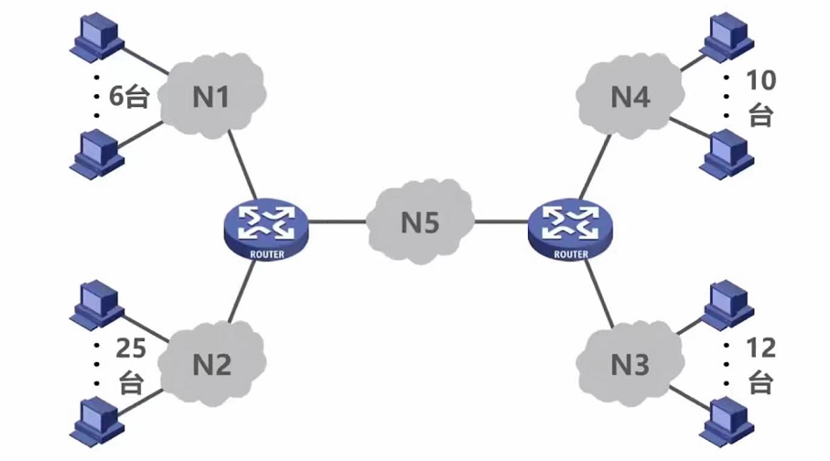
Exercises-3
Assuming that the applied IP address block is 218.75.230.0/24, please assign IP addresses to the devices in the figure below using fixed length and variable length subnet masks respectively.

Slide 128
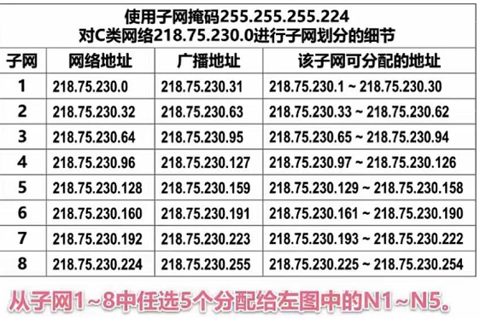
Exercises-3
Assuming that the applied IP address block is 218.75.230.0/24, please assign IP addresses to the devices in the figure below using fixed length and variable length subnet masks respectively.

Slide 129
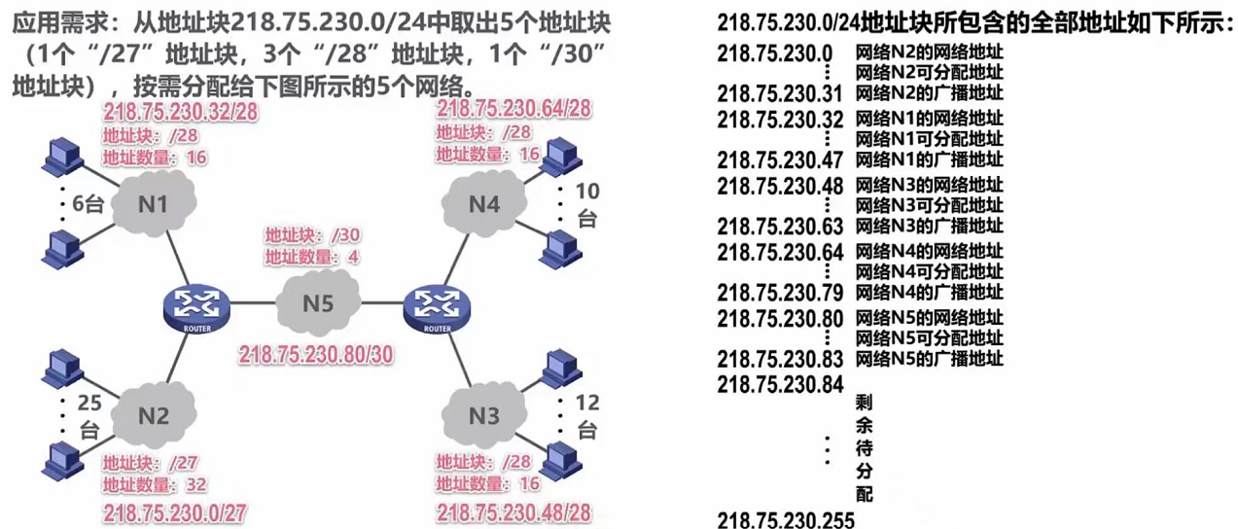
Exercises-3
Assuming that the applied IP address block is 218.75.230.0/24, please assign IP addresses to the devices in the figure below using fixed length and variable length subnet masks respectively.

Slide 130
NAT: Network Address Translation
rest of
Internet
local network
(e.g., home network)
10.0.0/24
10.0.0.1
10.0.0.4
10.0.0.2
138.76.29.7
10.0.0.3
all datagrams leaving local
network have same single source NAT IP address: 138.76.29.7,different source port numbers
datagrams with source or
destination in this network
have 10.0.0/24 address for
source, destination (as usual)

Slide 131
NAT: Network Address Translation
Motivation: local network uses just one IP address as far as outside world is concerned
Implementation: NAT router must:
Outgoing datagrams: replace (source IP address, port #) to (NAT IP address, new port #)
Remember (in NAT translation table) every translation pair
Incoming datagrams: replace (NAT IP address, new port #) with correspongding (source IP address, port #) stored in NAT table

Slide 132
NAT: Network Address Translation
NAT translation table
WAN side addr LAN side addr
2: NAT router
changes datagram
source addr from
10.0.0.1, 3345 to
138.76.29.7, 5001,
updates table
1: host 10.0.0.1
sends datagram to
128.119.40.186, 80
138.76.29.7, 5001 10.0.0.1, 3345
…… ……
S: 10.0.0.1, 3345
D: 128.119.40.186, 80
10.0.0.1
1
2
S: 138.76.29.7, 5001
D: 128.119.40.186, 80
10.0.0.4
10.0.0.2
138.76.29.7
S: 128.119.40.186, 80
D: 10.0.0.1, 3345
4
S: 128.119.40.186, 80
D: 138.76.29.7, 5001
3
10.0.0.3
4: NAT router
changes datagram
dest addr from
138.76.29.7, 5001 to 10.0.0.1, 3345
3: reply arrives
dest. address:
138.76.29.7, 5001
* Check out the online interactive exercises for more examples: http://gaia.cs.umass.edu/kurose_ross/interactive/

Slide 133
NAT: Network Address Translation
Outside node cannot initiate the communication
Reserved addresses:
10.0.0.0 – 10.255.255.255
172.16.0.0 – 172.31.255.255
192.168.0.0 – 192.168.255.255

Slide 134
LAN addresses and ARP
32-bit IP address:
network-layer address
used to get datagram to destination network (recall IP network definition)
LAN (or MAC or physical) address:
used to get datagram from one interface to another physically-connected interface (same network)
48 bit MAC address (for most LANs) burned in the adapter ROM
e.g.: 1A-2F-BB-76-09-AD

Slide 135

ARP: Address Resolution Protocol
Question: how to determine
MAC address of B
given B’s IP address?
Each IP node (Host, Router) on LAN has ARP module, table
ARP Table: IP/MAC address mappings for some LAN nodes
< IP address; MAC address; TTL>
< ………………………….. >
TTL (Time To Live): time after which address mapping will be forgotten (typically 20 min)
137.196.7.78
1A-2F-BB-76-09-AD
137.196.7.23
137.196.7.14
LAN
71-65-F7-2B-08-53
58-23-D7-FA-20-B0
0C-C4-11-6F-E3-98
137.196.7.88

Slide 136
ARP protocol：same LAN
A wants to send datagram to B
B’s MAC address not in A’s ARP table.
A broadcasts ARP query packet, containing B's IP address
destination MAC address = FF-FF-FF-FF-FF-FF
all nodes on LAN receive ARP query
B receives ARP packet, replies to A with its (B's) MAC address
frame sent to A’s MAC address (unicast)
A caches (saves) IP-to-MAC address pair in its ARP table until information becomes old (times out)
soft state: information that times out (goes away) unless refreshed
ARP is “plug-and-play”:
nodes create their ARP tables without intervention from net administrator
Notes:
ARP is “plug-and-play”:
nodes create their ARP tables without intervention from net administrator

Slide 137
Routing to another LAN
walkthrough: send datagram from A to B via R
focus on addressing – at IP (datagram) and MAC layer (frame)
assume A knows B’s IP address
assume A knows IP address of first hop router, R (how?)
assume A knows R’s MAC address (how?)
A
B
R
111.111.111.111
222.222.222.222
74-29-9C-E8-FF-55
49-BD-D2-C7-56-2A
222.222.222.220
1A-23-F9-CD-06-9B
111.111.111.112
111.111.111.110
222.222.222.221
CC-49-DE-D0-AB-7D
E6-E9-00-17-BB-4B
88-B2-2F-54-1A-0F

Slide 138
Routing to another LAN
A creates IP datagram with IP source A, destination B
A creates link-layer frame with R's MAC address as destination address, frame contains A-to-B IP datagram
MAC src: 74-29-9C-E8-FF-55
MAC dest: E6-E9-00-17-BB-4B
IP
Eth
Phy
IP src: 111.111.111.111
IP dest: 222.222.222.222
A
B
R
111.111.111.111
222.222.222.222
74-29-9C-E8-FF-55
49-BD-D2-C7-56-2A
222.222.222.220
1A-23-F9-CD-06-9B
111.111.111.112
111.111.111.110
222.222.222.221
CC-49-DE-D0-AB-7D
E6-E9-00-17-BB-4B
88-B2-2F-54-1A-0F

Slide 139
Routing to another LAN
frame sent from A to R
frame received at R, datagram removed, passed up to IP
MAC src: 74-29-9C-E8-FF-55
MAC dest: E6-E9-00-17-BB-4B
IP src: 111.111.111.111
IP dest: 222.222.222.222
IP
Eth
Phy
IP src: 111.111.111.111
IP dest: 222.222.222.222
IP
Eth
Phy
A
B
R
111.111.111.111
222.222.222.222
74-29-9C-E8-FF-55
49-BD-D2-C7-56-2A
222.222.222.220
1A-23-F9-CD-06-9B
111.111.111.112
111.111.111.110
222.222.222.221
CC-49-DE-D0-AB-7D
E6-E9-00-17-BB-4B
88-B2-2F-54-1A-0F

Slide 140
Routing to another LAN
R forwards datagram with IP source A, destination B
R creates link-layer frame with B's MAC address as destination address, frame contains A-to-B IP datagram
MAC src: 1A-23-F9-CD-06-9B
MAC dest: 49-BD-D2-C7-56-2A
IP
Eth
Phy
IP
Eth
Phy
IP src: 111.111.111.111
IP dest: 222.222.222.222
A
B
R
111.111.111.111
222.222.222.222
74-29-9C-E8-FF-55
49-BD-D2-C7-56-2A
222.222.222.220
1A-23-F9-CD-06-9B
111.111.111.112
111.111.111.110
222.222.222.221
CC-49-DE-D0-AB-7D
E6-E9-00-17-BB-4B
88-B2-2F-54-1A-0F

Slide 141
Routing to another LAN
R forwards datagram with IP source A, destination B
R creates link-layer frame with B's MAC address as destination address, frame contains A-to-B IP datagram
MAC src: 1A-23-F9-CD-06-9B
MAC dest: 49-BD-D2-C7-56-2A
IP
Eth
Phy
IP
Eth
Phy
IP src: 111.111.111.111
IP dest: 222.222.222.222
A
B
R
111.111.111.111
222.222.222.222
74-29-9C-E8-FF-55
49-BD-D2-C7-56-2A
222.222.222.220
1A-23-F9-CD-06-9B
111.111.111.112
111.111.111.110
222.222.222.221
CC-49-DE-D0-AB-7D
E6-E9-00-17-BB-4B
88-B2-2F-54-1A-0F

Slide 142
Routing to another LAN
R forwards datagram with IP source A, destination B
R creates link-layer frame with B's MAC address as dest, frame contains A-to-B IP datagram
MAC src: 1A-23-F9-CD-06-9B
MAC dest: 49-BD-D2-C7-56-2A
IP src: 111.111.111.111
IP dest: 222.222.222.222
IP
Eth
Phy
A
B
R
111.111.111.111
222.222.222.222
74-29-9C-E8-FF-55
49-BD-D2-C7-56-2A
222.222.222.220
1A-23-F9-CD-06-9B
111.111.111.112
111.111.111.110
222.222.222.221
CC-49-DE-D0-AB-7D
E6-E9-00-17-BB-4B
88-B2-2F-54-1A-0F
* Check out the online interactive exercises for more examples: http://gaia.cs.umass.edu/kurose_ross/interactive/

Slide 143
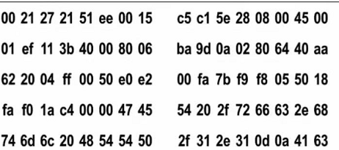
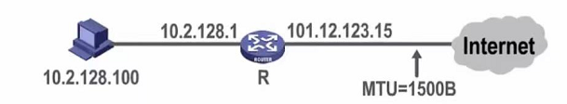
Exercises-4
Figure 1 shows the network topology, and Figure 2 shows the hex-content of the first 80 bytes of an Ethernet frame of the host for a Web request.
(1) What is the IP address of the Web server? What is the MAC address of the default gateway of this host?
(2) When the IP packet encapsulated in this frame is forwarded through router R, which fields in the IP packet need to be modified？
Fig. 1
Fig. 2
Notes:
(1)40 aa 62 20,64.170.98.32; 00-21-27-21-51-ee
(2) TTL字段，首部校验和重新计算，总长字段若大于MTU，则总长字段、标志字段、片偏移字段都需要修改

Slide 144
ICMP: Internet Control Message Protocol
used by hosts, routers, gateways to communication network-level information
error reporting: unreachable host, network, port, protocol
echo request/reply (used by ping)
network-layer “above” IP:
ICMP msgs carried in IP datagrams
ICMP message: type, code plus first 8 bytes of IP datagram causing error
Type Code description
0 0 echo reply (ping)
3 0 dest. network unreachable
3 1 dest host unreachable
3 2 dest protocol unreachable
3 3 dest port unreachable
3 6 dest network unknown
3 7 dest host unknown
4 0 source quench (congestion
control - not used)
8 0 echo request (ping)
9 0 route advertisement
10 0 router discovery
11 0 TTL expired
12 0 bad IP header

Slide 145
ICMP:brief summary
ICMP is the control sibling of IP
ICMP is used by IP and uses IP as network layer protocol
ICMP is used for ping, traceroute, and path MTU discovery
Ping: uses ICMP Echo request/reply messages
Path MTU discovery
Send a large IP datagram with”No fragment” bit set
Reduce size until success (No ICMP message received)

Slide 146
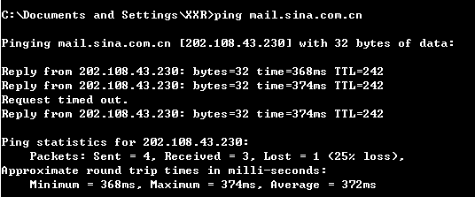
ping

Slide 147
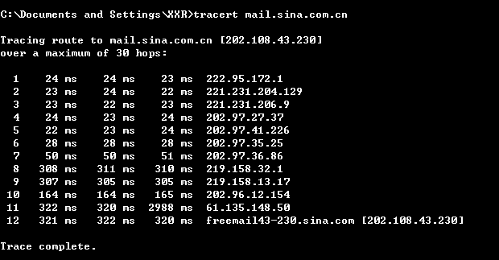
traceroute

Slide 148
Traceroute and ICMP
Source sends series of UDP segments to dest.
First has TTL=1
Second has TTL=2, etc.
Unlikely port number
When nth datagram arrives to nth router:
Router discards datagram
And sends to source an ICMP message (type 11, code 0)
Message includes name of router & IP address
When ICMP message arrives, source calculates RTT
Traceroute does this 3 times
Stopping criterion
UDP segment eventually arrives at destination host
Destination returns ICMP “host unreachable” packet (type 3, code 3)
When source gets this ICMP, stops

Slide 149
IPv6
Initial motivation: 32-bit address space completely allocated by 2008.
Additional motivation:
header format helps speed processing/forwarding
header changes to facilitate QoS
new “anycast” address: route to “best” of several replicated servers
IPv6 datagram format:
fixed-length 40 byte header
no fragmentation allowed

Slide 150
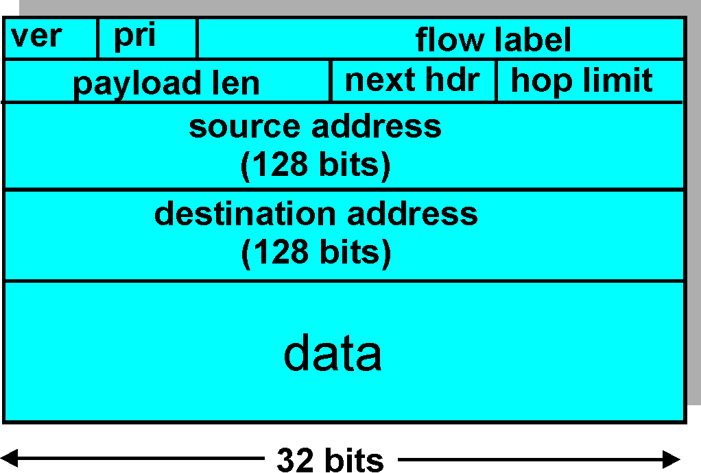
IPv6 Header (Cont)
Priority: identify priority among datagrams in flow
Flow Label: identify datagrams in same “flow.”
(concept of“flow” not well defined).
Next header: identify upper layer protocol for data

Slide 151
Next header
Without extension header
Basic header
Next header
= TCP/UDP
TCP/UDP header
and data
(TCP/UDP segment）
Effective payload
With extension header
Basic header
Next header
= routing
selection
Routing header
Next header
= fragment
Fragment header
Next header
= TCP/UDP
TCP/UDP header
And data
(TCP/UDP segment）
Effective payload

Slide 152
Other Changes from IPv4
Checksum: removed entirely to reduce processing time at each hop
Options: allowed, but outside of header, indicated by “Next Header” field
ICMPv6: new version of ICMP
additional message types, e.g. “Packet Too Big”
multicast group management functions

Slide 153
IPv6 address
Three types: unicast, multicast, anycast
Colon hexadecimal notation:
68E6:8C64:FFFF:FFFF:0:1180:960A:FFFF
Zero compression:
FF05:0:0:0:0:0:0:B3 == FF05::B3 ;
0:0:0:0:0:0:128.10.2.1 == ::128.10.2.1
12AB:0000:0000:CD30:0000:0000:0000:0000/60
== 12AB::CD30:0:0:0:0/60
== 12AB:0:0:CD30::/60

Slide 154
Unicast address
Second
level
First level
Third level
bit 0 48 64 127
Global routing prefix
（48 bit）
Subnet
ID
（16 bit）
Interface ID
（64 bit）

Slide 155
EUI-64
G/L bit
I/G bit
bit 0 8 24 47
IEEE 802
address
ccccc c0gcccccccccccccccc
low 24 bit
bit 0 8 24 40 63
interface
ID
cccccc1gcccccccccccccccc 1111111111111110
low 24 bit
0xFFFE
G/L = 1

Slide 156
Example:
host MAC address: 00:0C:85:AB:50:01
insert FFFE： 00:0C:85:FF:FE:AB:50:01
set G/L bit: 02:0C:85:FF:FE:AB:50:01
host EUI-64 is: 020C:85FF:FEAB:5001
router advertise the 64bit network prefix
Host unicast address: prefix+EUI-64

Slide 157
Transition From IPv4 To IPv6
Not all routers can be upgraded simultaneous
no “flag days”
How will the network operatewith mixed IPv4 and IPv6 routers?
Two proposed approaches:
Dual Stack: some routers with dual stack (v6, v4) can “translate” between formats
Tunneling: IPv6 carried as payload n IPv4 datagram among IPv4 routers

Slide 158
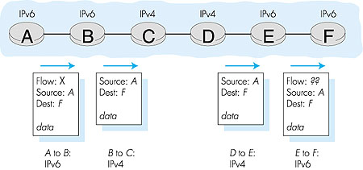
Dual Stack Approach

Slide 159
Tunneling
A
B
IPv4 tunnel
connecting IPv6 routers
E
F
logical view:
IPv6
IPv6
IPv6
IPv6
A
B
C
D
E
F
physical view:
IPv6
IPv6
IPv4
IPv4
IPv6
IPv6

Slide 160
Tunneling
A
B
IPv4 tunnel
connecting IPv6 routers
E
F
logical view:
IPv6
IPv6
IPv6
IPv6
A
B
C
D
E
F
physical view:
IPv6
IPv6
IPv4
IPv4
IPv6
IPv6
flow: X
src: A
dest: F
data
src:B
dest: E
src:B
dest: E
flow: X
src: A
dest: F
data
Flow: X
Src: A
Dest: F
data
Flow: X
Src: A
Dest: F
data
A-to-B:
IPv6
B-to-C:
IPv6 inside
IPv4
B-to-C:
IPv6 inside
IPv4
E-to-F:
IPv6

Slide 161
Summary
Virtual circuit and datagram networks
Routing algorithms:
Dijkstra’s algorithm
Broadcast routing
Link state
Distance vector (“count to infinity” problem)
Routing in the Internet (RIP, OSPF, BGP)
IP: Internet protocol
IPv4 Datagram format
IPv4 addressing
IP fragment
NAT
ARP
ICMP
IPv6
From IPv4 to IPv6

Slide 162
Homework
P455:R4,R5
P457:P3,P5
P458:P11
P396:P14
P395:P8,P11,P12

